Slide 1



Webscraping Project
Theme : Marvel universe

Slide 2


Problematic
With this project, the problematic was to look at the best rated Marvel/Superhero movies on IMDB, and cross this data with Amazon Data on best rated Marvel/Superhero-related toys, in order to find the most popular superheroes nowadays.

Slide 3


Methodology
Use of Python: BeautifulSoup, IMDbPY
Scrape IMDb & Amazon
Compare the best results of each category

Slide 4
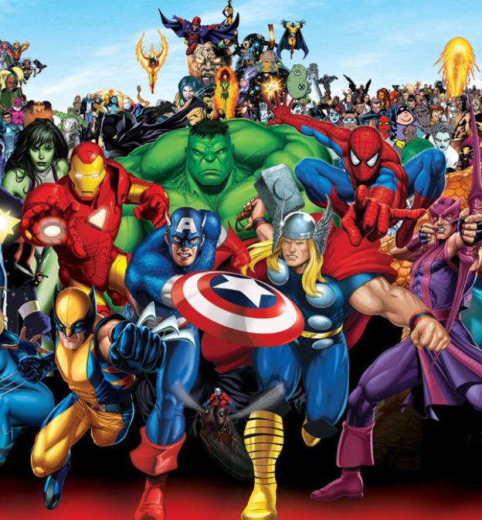
Results
The results we were looking for were:
Top50 marvel movies on IMDb
Top20 marvel toys on Amazon

Slide 5
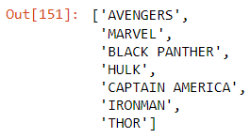
Here are the final superheroes present on IMDB top50 and Amazon top20: We can get rid of Avengers and Marvel, which gives us: - Black Panther - Hulk - Captain America - Ironman - Thor

Slide 6
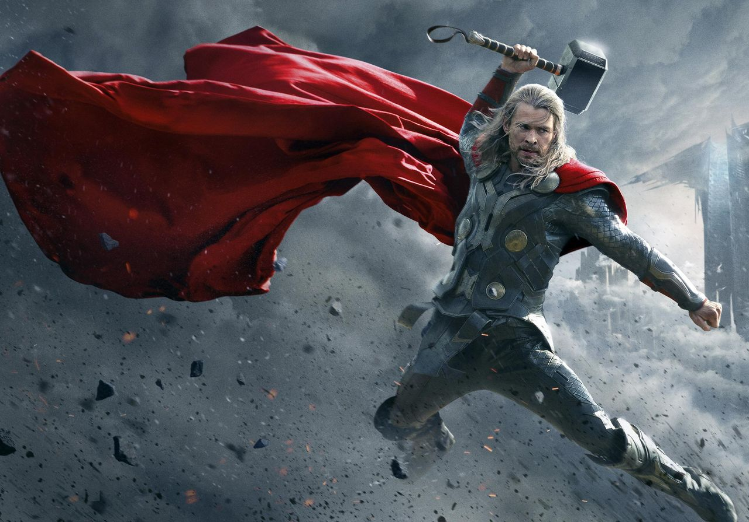
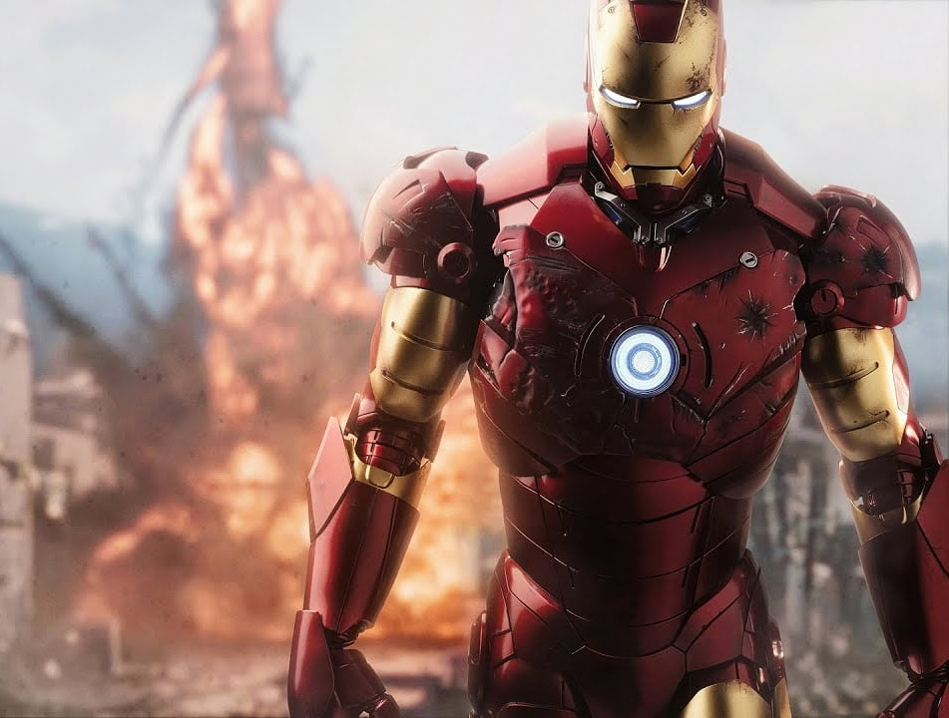
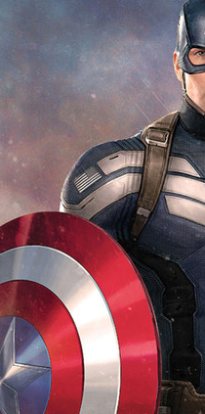
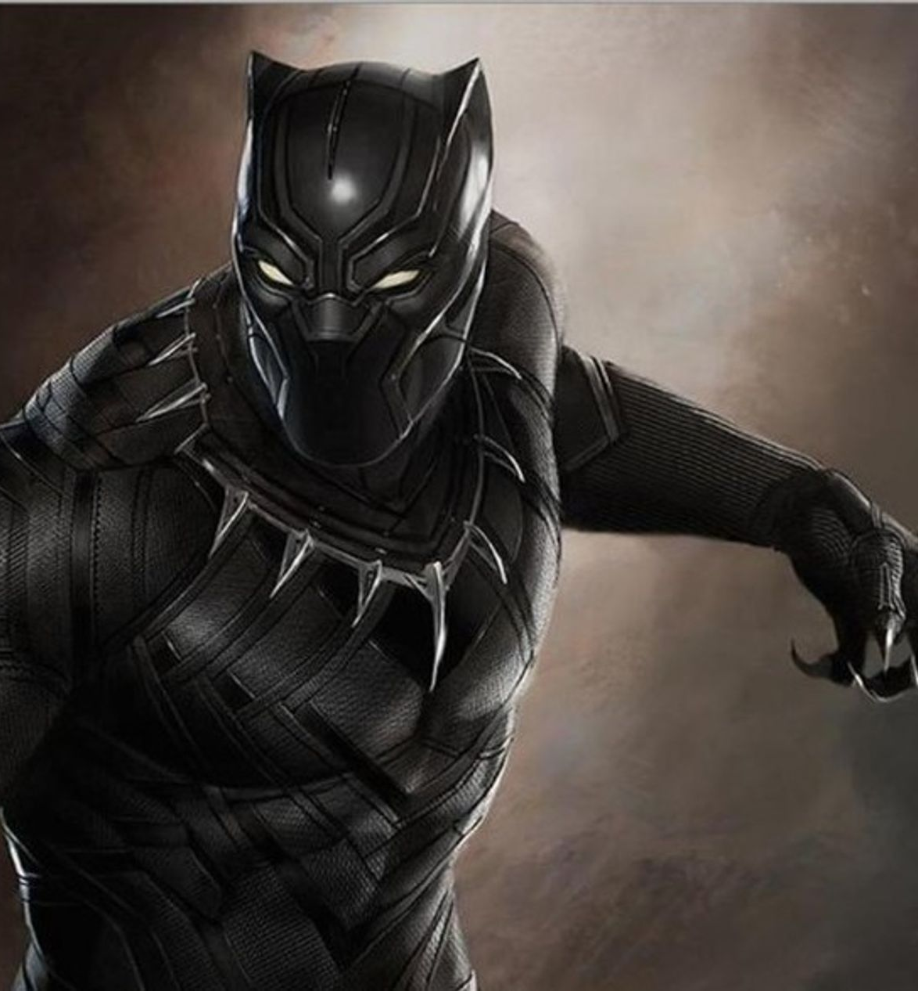
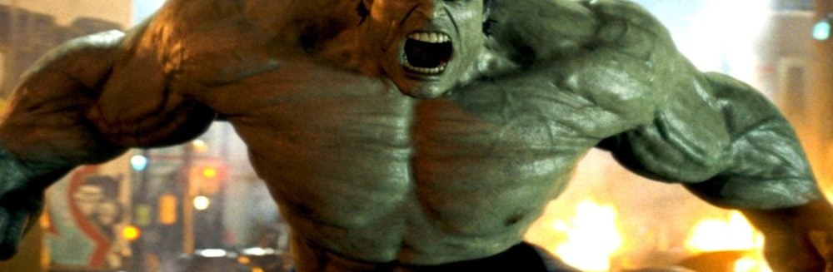
Conclusion
Thanks to scraping IMDB and Amazon, we were able to get the top 5 of the most popular Marvel Superheroes today.

Slide 7
Links to the project
Github: https://github.com/mehdinoureddine/webscraping_project_marvel
Sites used:
- amazon.com
- imdb.com

